Slide 1
Bed/mattress tester
my dream job

Slide 2
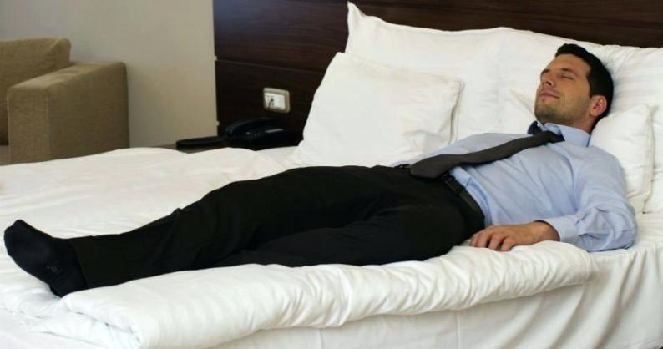
Bed/matress tester is an actual job. You can sleep a few hours and rest in the bed. Then you need to write an opinion about your sleep and how good was the mattress. These mattresses are usually made for luxury hotels and expensive beds by very good companies.

Slide 3
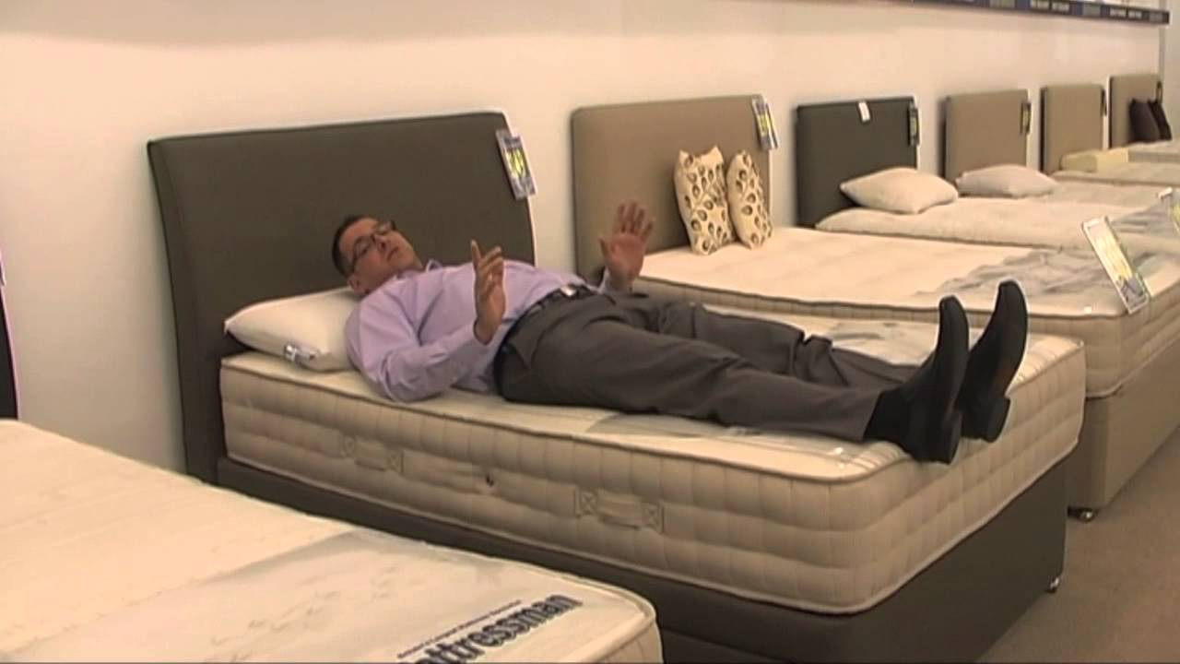
This job is perfect for lazy people. You can sleep all the day in different beds and then you have about 5000 or 6000 zlotych. I don’t lie! You can earn much money by sleeping! It’s a perfect job.

Slide 4
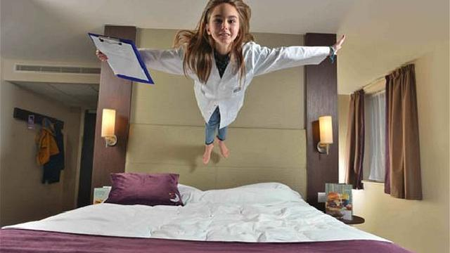
I surfed the internet and found several offers from polish companies which make mattress. Yeah, this job is real.

Slide 5
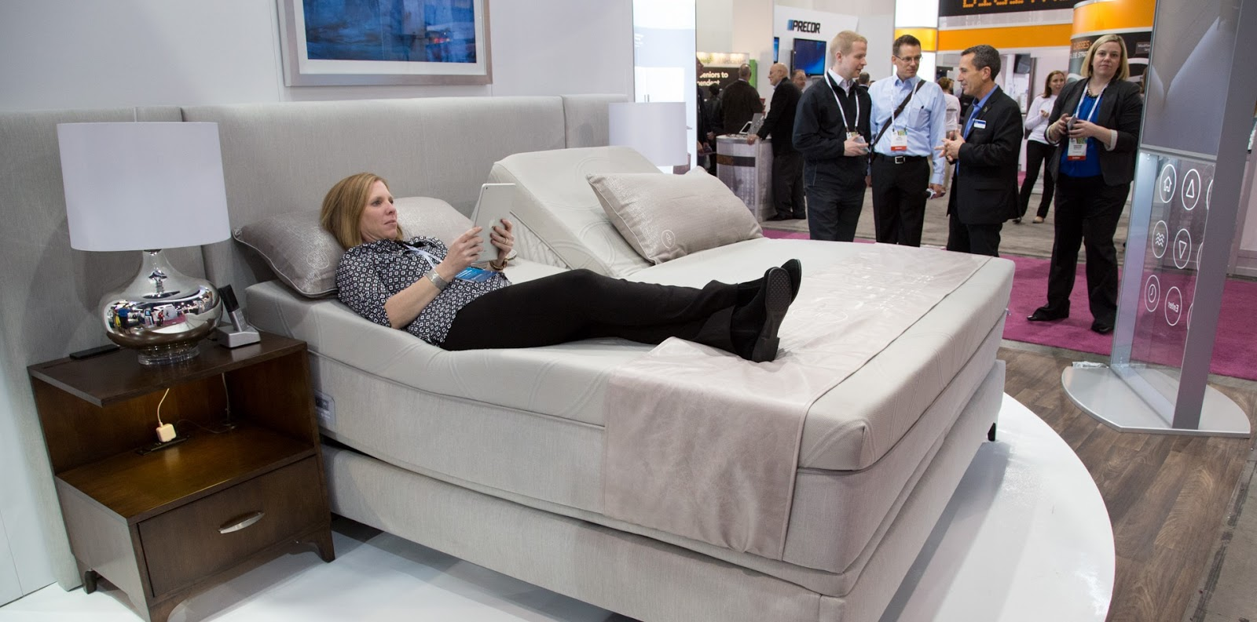
Many people want this job. You will be very lucky if you get it. I am not shocked about this fact. I read that someone had 25000 applicants, but if you have more experience and good writing skills, you will get this job easier.

Slide 6
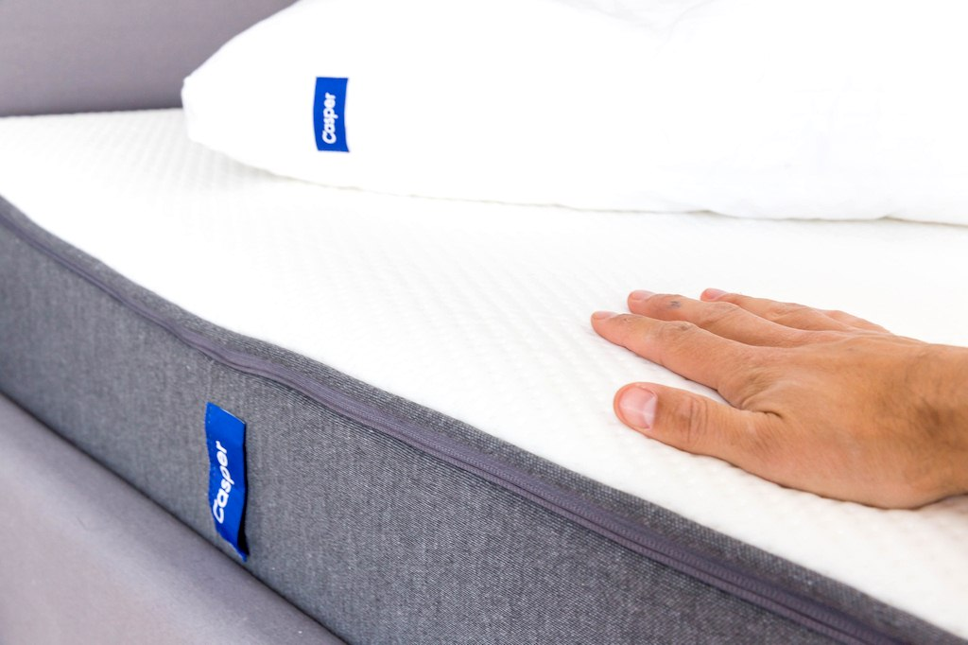
“Perfect job doesn’t exist.” Are you sure?

